Slide 1
Airport Network
Group Member: Han Yin, Keyu Wu, ZiYue Guo

Slide 2
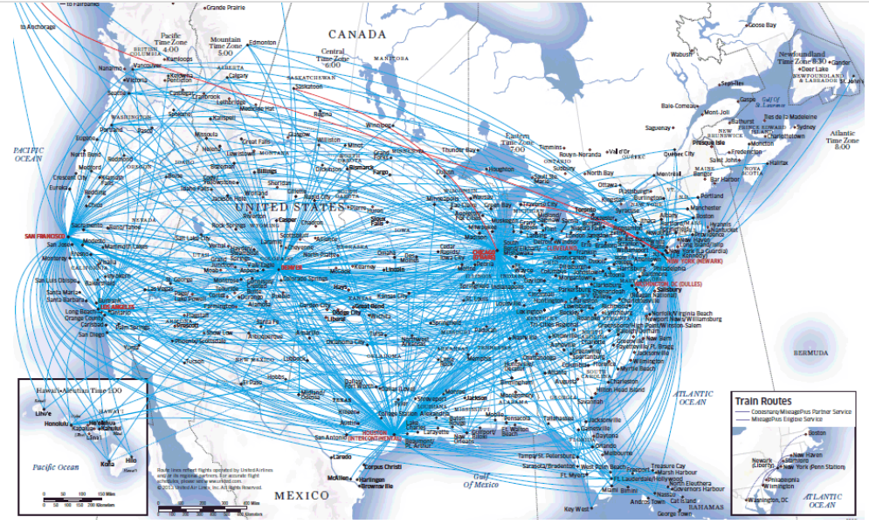
Introduction

Slide 3
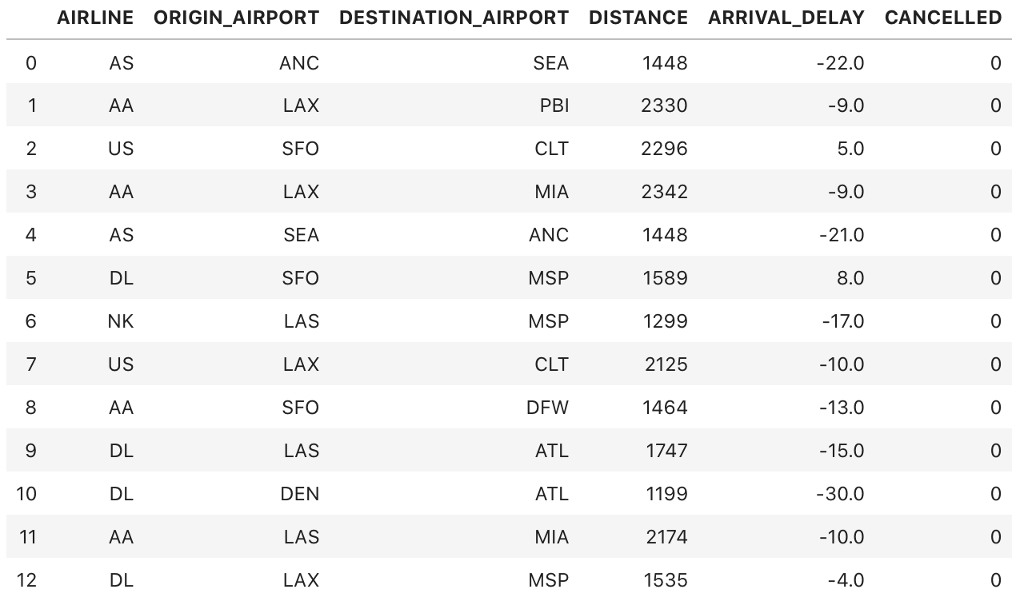
2015 flight delay and cancellation
Useful Column: Airline, Original Airport, Destination, Arrival Delay, Cancellation , Distance, longitude , latitude
Dataset Size: 5819079 X 31

Slide 4
Methods and Achievement
Page Rank
Authority and Hub
K - means Clustering
Linear Regration

Slide 5
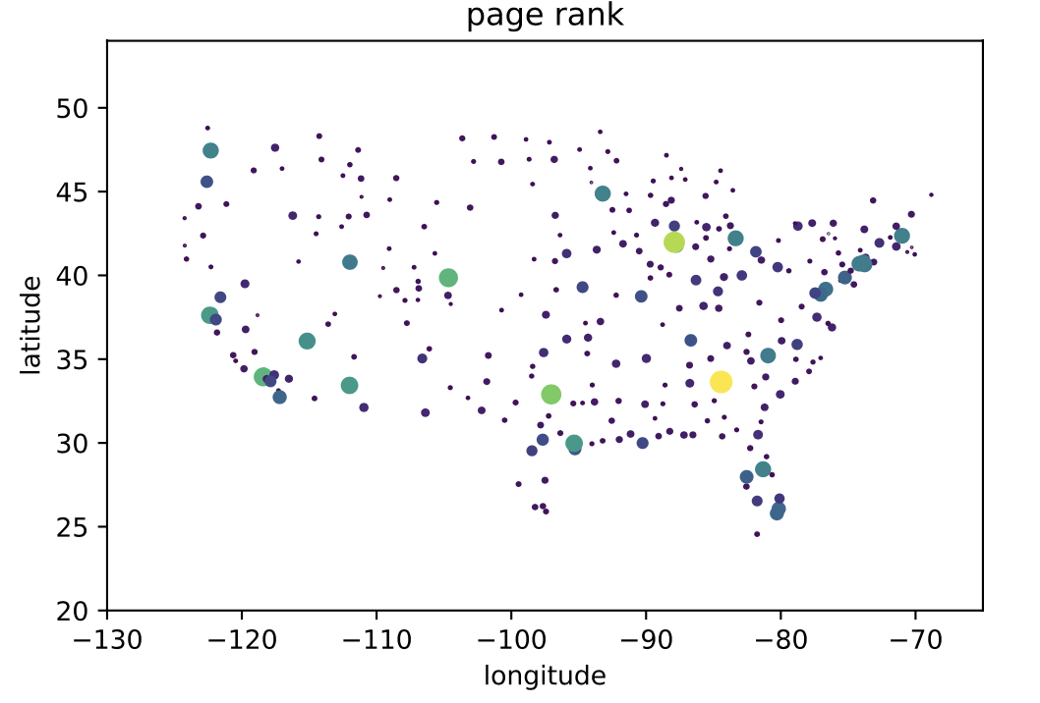

Slide 6
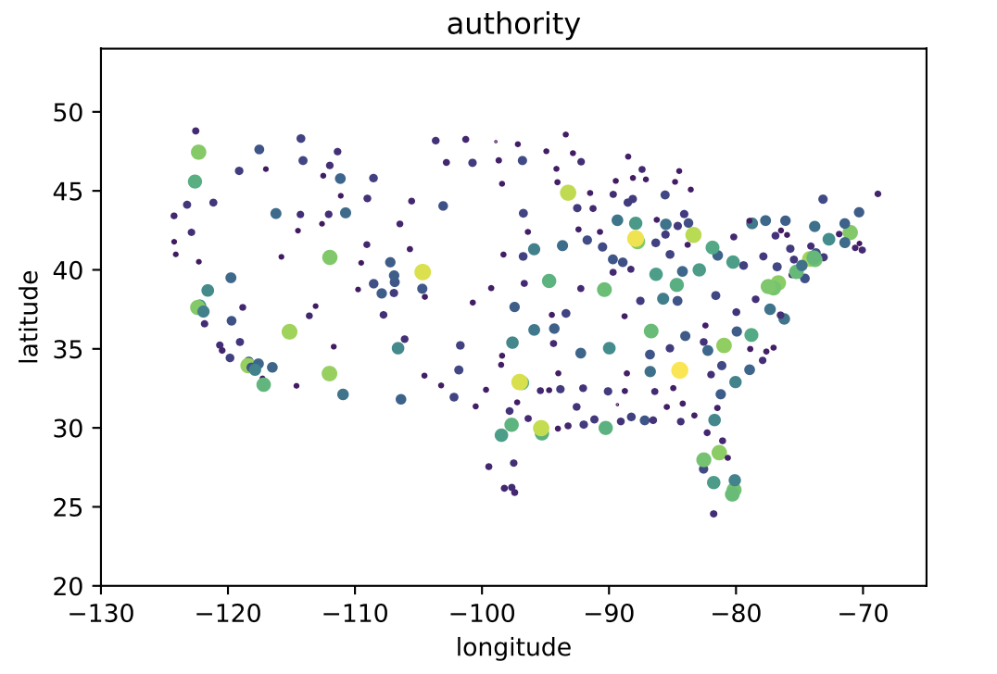

Slide 7
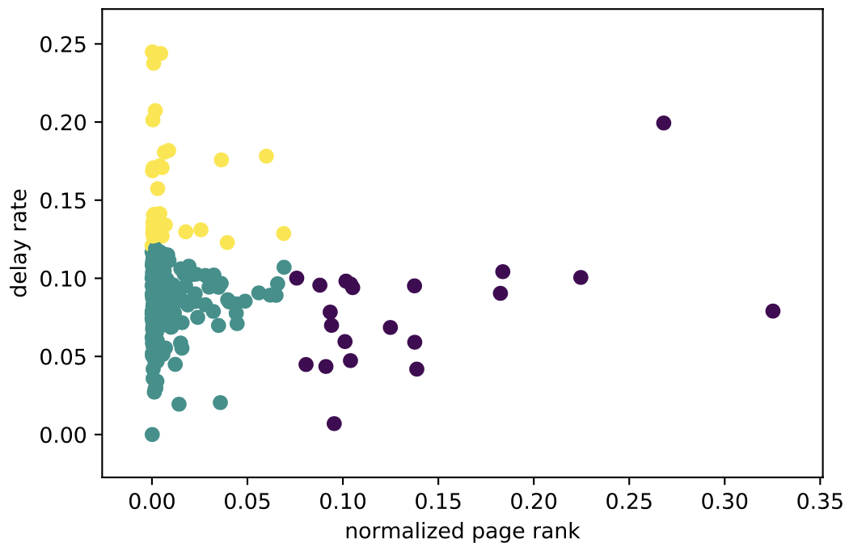
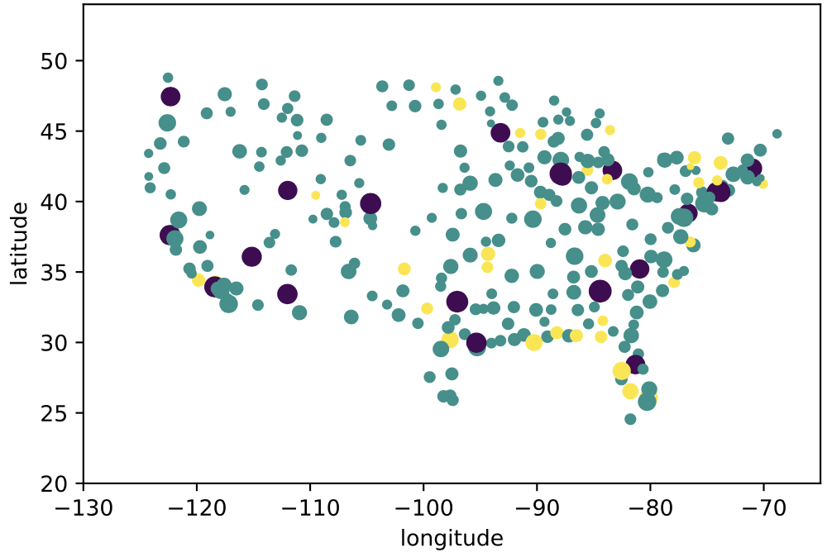
K-means K = 3
delay rate & pagerank (normalized)

Slide 8
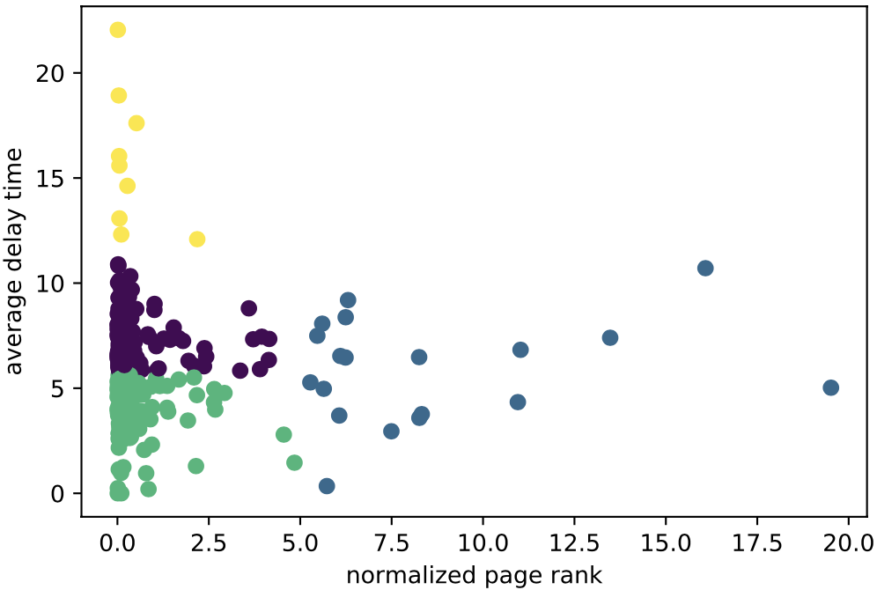
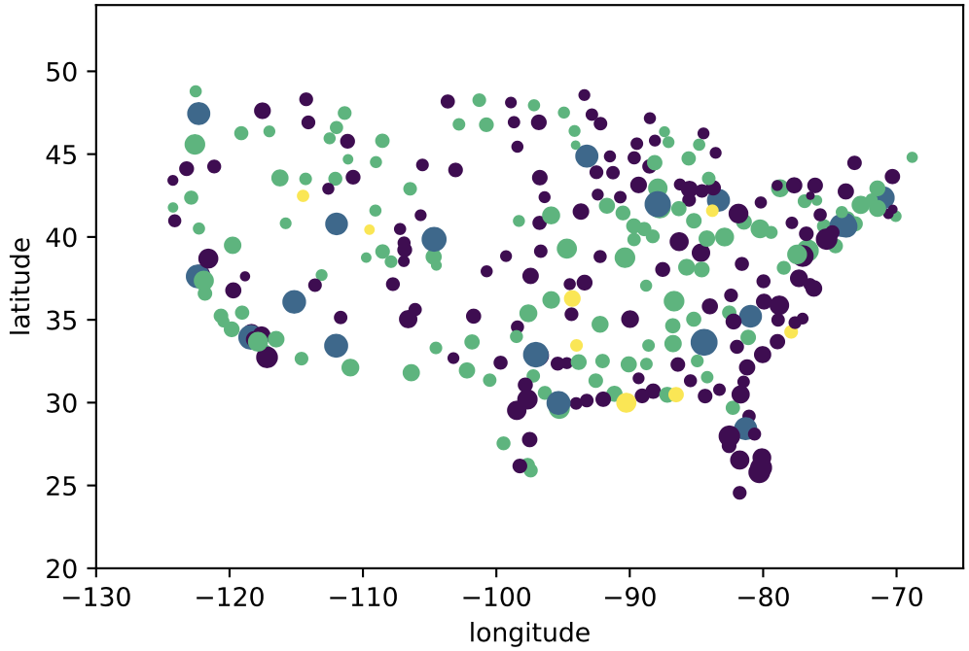
K-means K = 4
Average delay time & pagerank (normalized)

Slide 9
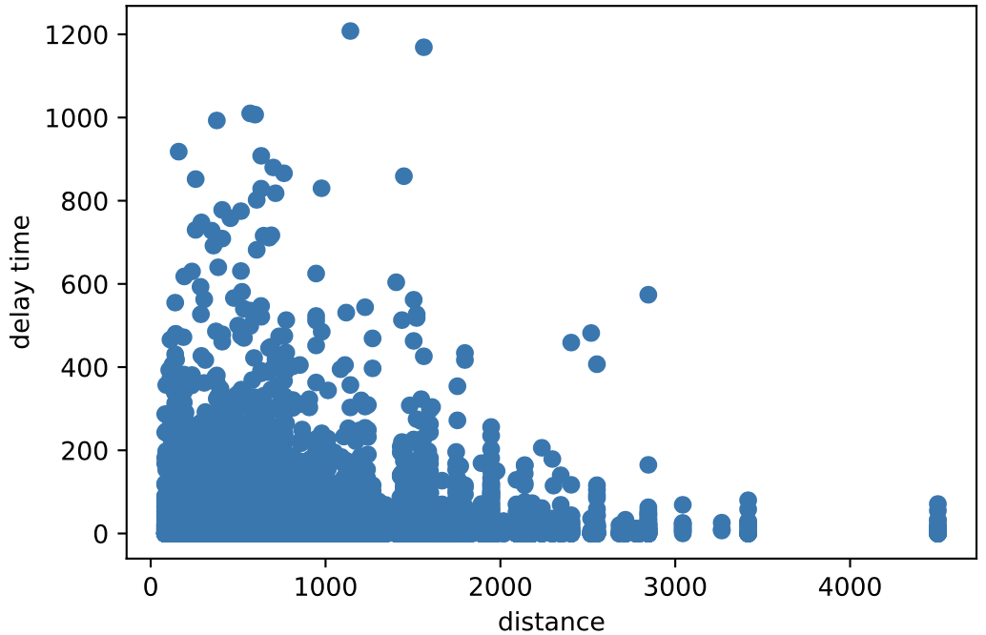
Linear regration
slope = 0.0007752
intercept = 11.2048
correlation = 0.012603
p-value = 3.62e-20
5000 * slope = 3.876

Slide 10
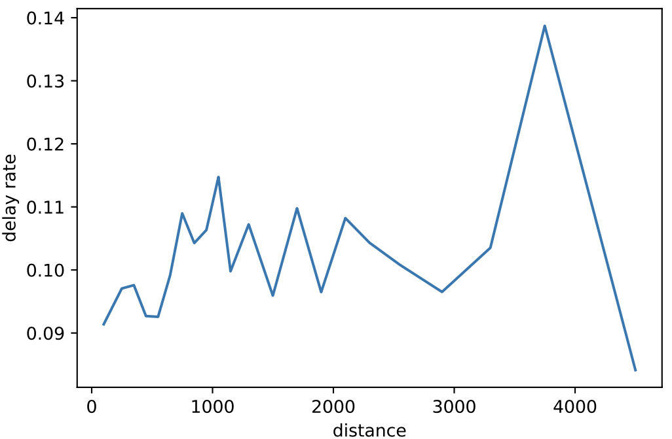

Slide 11
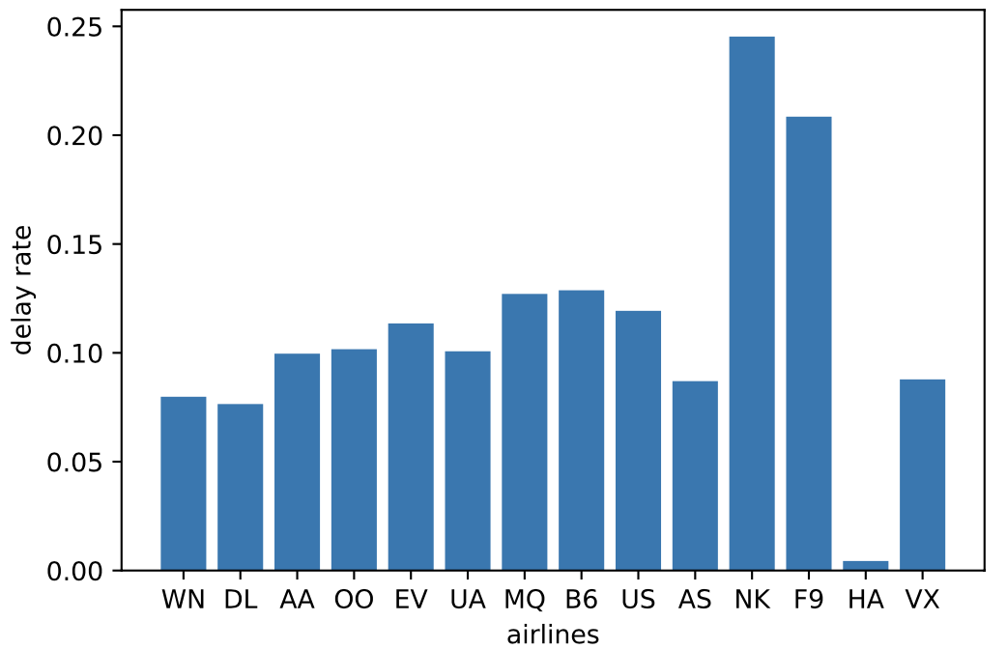

Slide 12
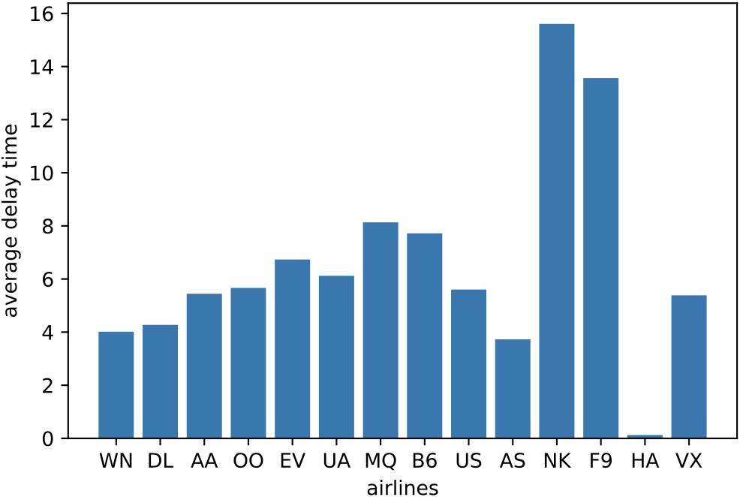

Slide 13
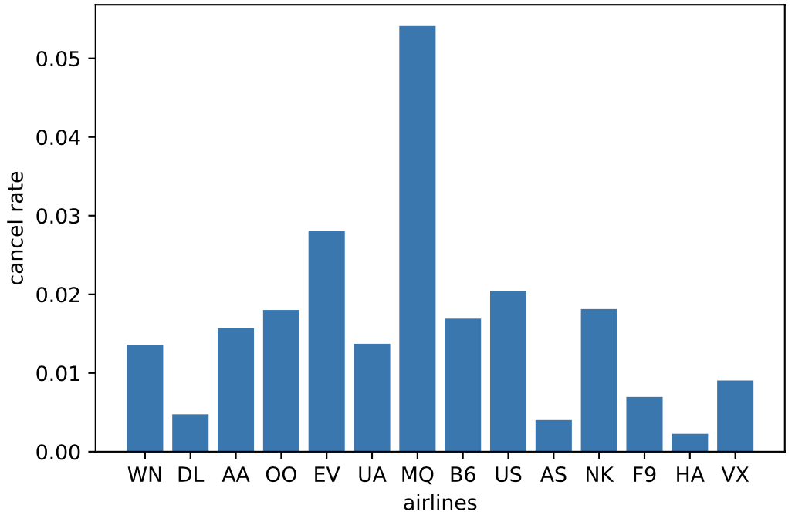

Slide 14
Conclusion & thoughts
work still to do:
Adding more data from some other aspects.
unanswered questions:
what are overall worst airlines and airports?

